Slide 1


Factor Affecting Online Banking - Sri Lanka
Isham Mohamed - 209333X

Slide 2
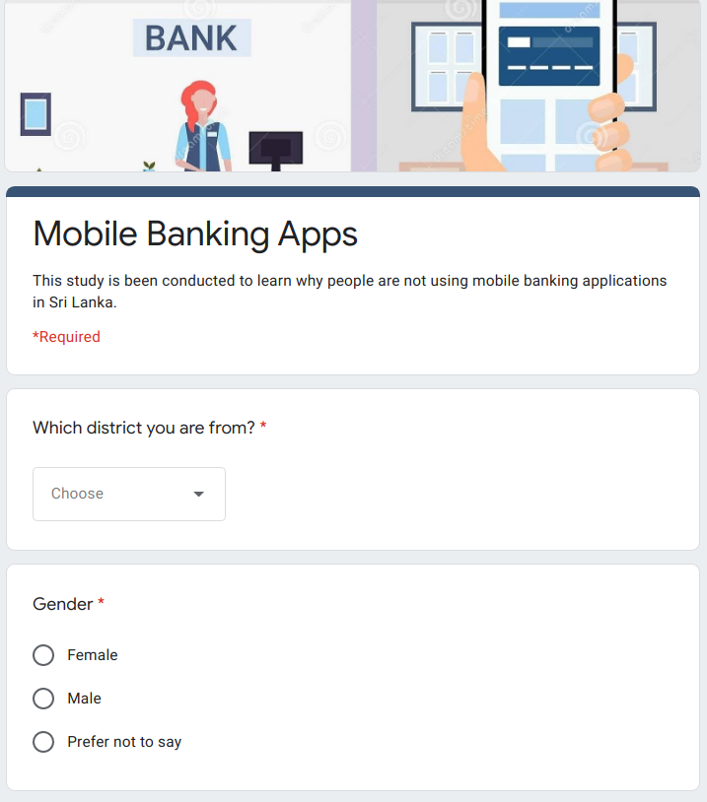
Questionnaire
Primary Target Groups - Non internet banking application users
Students
Graduates
Snowballing Sampling
Google Forms
4 weeks data collection
142 total responses.
Broken into 3 sections,
Demographic information.
Understanding existing banking needs
Why not internet banking applications.

Slide 3
Results & Insights

Slide 4
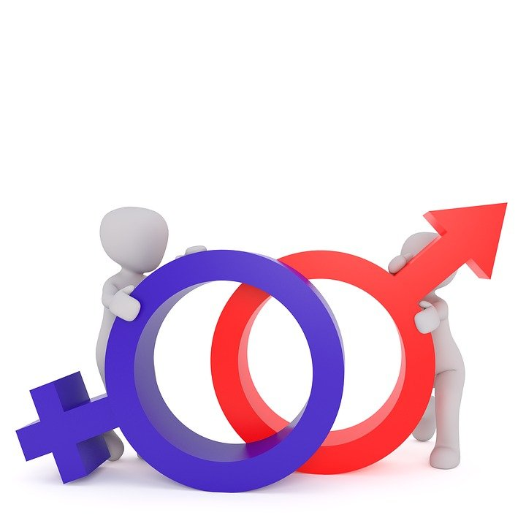
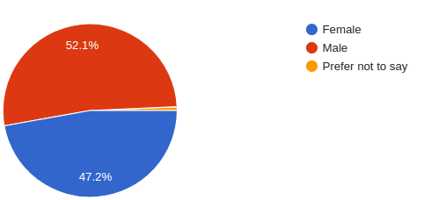
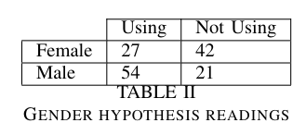

Gender Hypothesis
Are women less likely to use online banking applications?
Difference in Proportion Hypothesis testing.
There is only a 0.003% chance of this happening if the proportions were equal
Strong Evidence Supporting The Hypothesis!!!

Slide 5
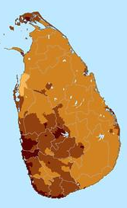
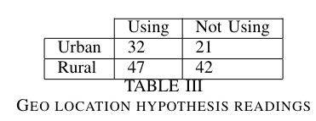
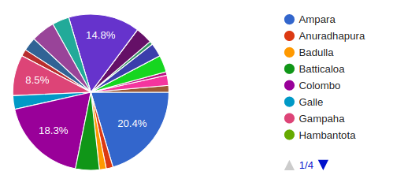

Geo Location Hypothesis
People lives in urban areas are more likely to use mobile banking applications than people lives in rural areas
Colombo
Gampaha
Kalutara
Kandy
Galle
Difference in Proportion Hypothesis testing.
There is a 17% of this happening if the proportions were equal
No Evidence Supporting The Hypothesis!!!
Source : https://www.researchgate.net/publication/314257911_Re-Defining_Urban_Areas_in_Sri_Lanka

Slide 6

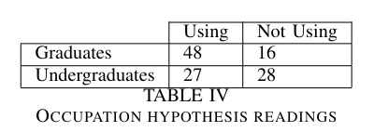
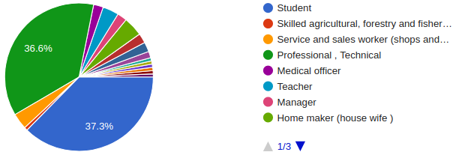
Occupation Hypothesis
People who have graduated and working are more likely to use the banking applications than people who are undergraduates
Difference in Proportion Hypothesis testing.
There is only a 0.17% chance of this happening if the proportions were equal
Strong Evidence Supporting The Hypothesis!!!

Slide 7
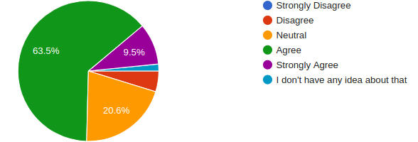
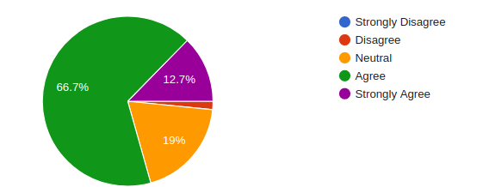
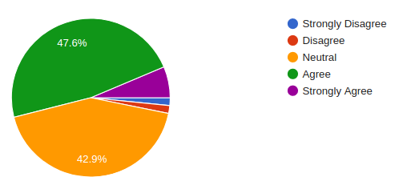
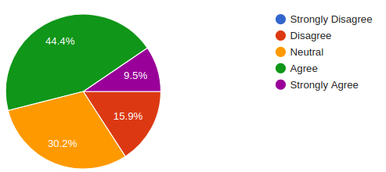
Why Not Internet Banking Hypothesis
Transaction fee should be reduced
User experience should be improved
ATM / Bank Counters are more secure
Afraid of mistakes
Notes:
Secure - 3.554 0.7078728699420539 6.211904518037686
3.475 0.8702729456900289 4.3321990381738225
3.729 0.6731061907307049 8.59635254731035
3.9050000000000002 0.6098975323773659 11.777740404261626
3.035 0.8916200003364662 0.31157206832165013r 62.15781%

Slide 8
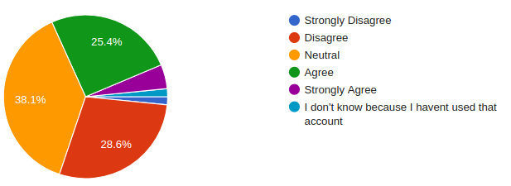
Why Not Internet Banking Hypothesis Cont..
Getting onboard is time consuming

Slide 9
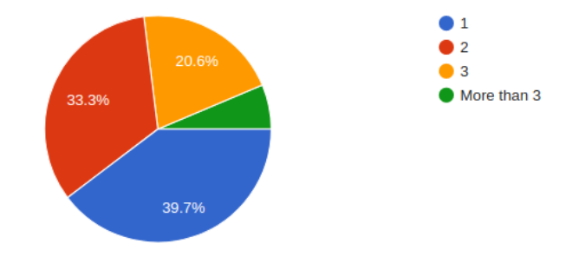
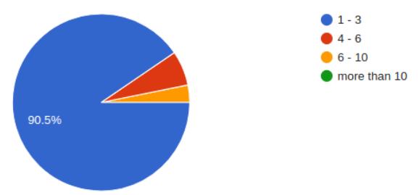
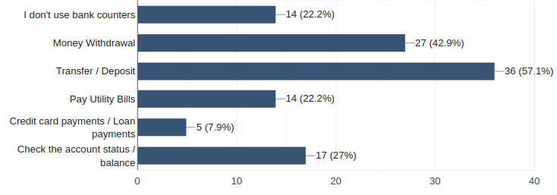
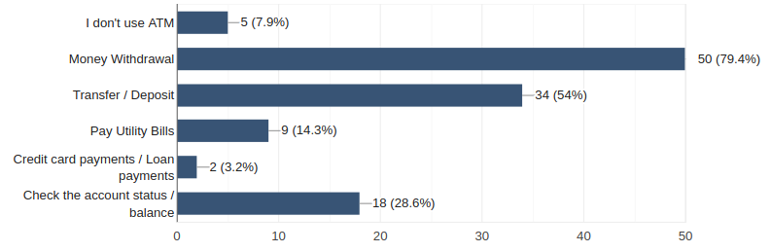
Non Users’ Needs
Average Travelling Distance to Access Banking Services
Frequency of Accessing Banking Services
Frequently Accessed Services

Slide 10
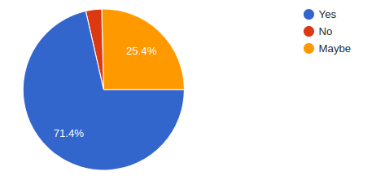
COVID-19 An Opportunity?

Slide 11
Conclusions
Women are significantly low when it comes to mobile banking usage - Ads attracting more women
Student related campaign, special offers.
Reduce The transaction fee and improve overall usability of the application.
More social media marketing campaign during the current situation.
No evidence to conclude the the effects of geolocation

Slide 12
Q&A

Slide 13
Thank You!

